Slide 1
Higher Biology
Social Behaviour
Mr G R Davidson

Slide 2
Social Behaviour
Many species of animals like to live in social groups.
These groups can vary in size from two individuals to several thousand individuals.
The success of the group is based on behavioural adaptations which have evolved by natural selection.

Slide 3
Social Hierarchy
Social hierarchy is a system involving the members of the group being ranked.
The higher ranking animals dominate the lower ranking animals, e.g.

Slide 4
Social Hierarchy
In grey wolves the dominant male gets first choice of mates, food and sleeping spots. He uses social signals such as bearing his teeth, raising his hackles and tail, to assert his authority over other members of the group.
In young birds a “pecking order” soon becomes established and one of the chicks will become dominant. This chick can intimidate all the others and so gets first choice of any food available.

Slide 5
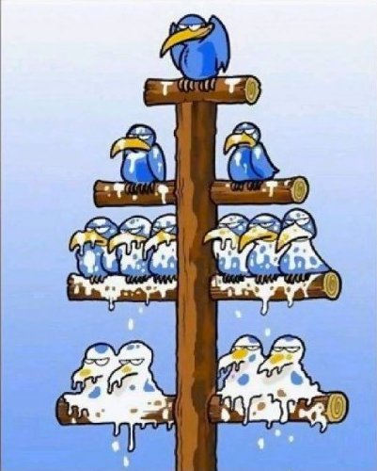
Pecking Order

Slide 6
Social Hierarchy
There are a number of advantages in having a social hierarchy such as:
Conservation of energy
Reduced aggression
The most favourable genes get passed on to the next generation
Serious injury is usually avoided
The group leader is experienced and so can look after the group

Slide 7
Cooperative Hunting
Some bigger mammals adopt a cooperative approach to hunting their prey such as:
Lions use an ambush strategy where some of the pride will drive the prey towards the others which are ready in hiding.
Hunting dogs work together to single out one prey individual and then chase it until the prey is exhausted.

Slide 8
Cooperative Hunting
Cooperative hunting allows much larger prey animals to be caught.
It also allows the subordinate members of the group to benefit as they get fed.
It reduces the amount of energy consumed in catching their prey.

Slide 9
Cooperative Defence
By working as a large group, animals have also developed defence mechanisms.
A large group of animals have many eyes to spot predators.

Slide 10
Cooperative Defence
If a predator appears, an alarm call will be sounded and the animals will scatter causing confusion in the predator, e.g. quail.
A number of animals will form defensive groups by creating a circle in which they can protect the younger individuals, e.g. musk ox.

Slide 11
Altruistic Behaviour
Altruism is a type of unselfish behaviour in which a member of a group (donor) behaves in a disadvantageous way in order to benefit another (recipient).
There are 2 types of altruism:
Reciprocal altruism
Kin selection altruism

Slide 12
Reciprocal Altruism
This type of behaviour involves one individual helping another on the assumption that at a later date the favour will somehow be returned, e.g.
Vampire bats require a blood meal at least once every 2 days.
If a bat fails to get blood it will die.

Slide 13
Reciprocal Altruism
Bats who feed well one night can regurgitate some blood and help to feed the less successful bats.
This means that on the next feed the favour may be returned.
In this way a greater number of the group are likely to survive as they are looking after each other.

Slide 14
Kin Selection
This occurs in some species of animals.
For example, in birds, if one member of a flock gives a warning of predators, the rest remain motionless which protects them.

Slide 15
Kin Selection
The caller, however, may be caught by the predator and it would seem foolish to do this.
However, each bird contains the same altruistic gene and will use it if it benefits the rest of the flock.
In this case “the needs of the many outweigh the needs of the one”.

Slide 16
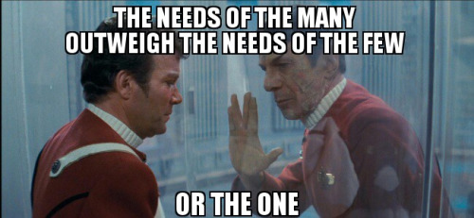
Kin Selection

Slide 17
Relatedness
The proportion of genes identical in two individuals is referred to as the coefficient of relatedness.
E.g. a parent and child would have a coefficient of 0.5.
In other words 50% of their genes will be the same.

Slide 18
Social Insects
Some insects live in social colonies where complex social behavioural patterns exist.
There is a division of labour which means that each individual within the colony has a specific task to do, e.g. reproduction, food collection, protecting the colony, etc..

Slide 19
Keystone Species
Ecosystems are generally very stable but they often rely on one species to maintain this stability.
This species is referred to as the keystone species.
E.g. honey bees for pollinating plants which form the bottom layer of the food chains within the ecosystem.

Slide 20
Keystone Species
Species which put selective pressures on other species
Species which decompose
Species which pollinate
Keystone species
Species which provide resources
Predators

Slide 21
Primate Behaviour
Primates are a large and diverse group of mammals including apes, monkeys and humans.
Primates have a long period of parental care which allows time for the young to learn complex social behaviours by watching and copying others in the group.

Slide 22
Primate Behaviour
These behaviours help to support the social structure of the group and reduce conflicts.
Dominance hierarchies are common and these also help to keep order.

Slide 23
Alliances
In some groups individuals may become allies which may help to improve their social status.
The more alliances an individual has, the better the chances of climbing the social ladder.

Slide 24
Ritualistic Display
A ritualistic display is used when two primates are competing for a single resource.
The display is designed to make the animal look much larger or fiercer than normal.
This usually results in one animal conceding to the other without any physical contact.

Slide 25
Appeasement Behaviour
Appeasement behaviour is used to reduce tensions.
The animal tries to look unthreatening to reduce aggression and may use techniques such as:
Grooming
Kissing
Hugging

